Slide 1
From Functional to Parallel
Stochastic Modelling in C++

Slide 2
Who are you again?
Hello, my name is Kevin Carpenter

Slide 3
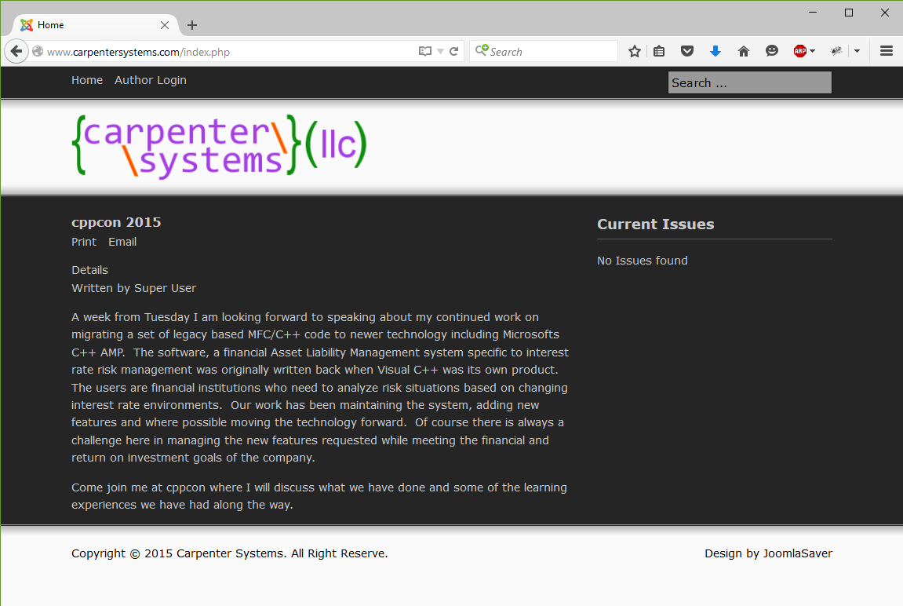
Not a Web Designer
Notes:
Obvious yes?

Slide 4

Not a financial consultant
Me when asked to explain target financial structures.
Notes:
Many fundamentals of interest rate risk management I understand and it took way to long as my coworkers who are consultants will attest. Actually I can explain a Target Financial Structure just barely now.

Slide 5



Have a favorite?
C++
.NET/php
Notes:
Ever where a lot of hats? Yea me to. And I love C++. Coding in it at least 10 years. Programming over 20. I have spent a year using CUDA with Nvidia, and as of this project almost a year using CPP AMP.

Slide 6

Notes:
Though I may say I or me, or we, there are a team of programmers who work on this project.
Due to the nature of the project I cannot release live code beyond what you see on the slides.
Though I work for the company in this case I represent myself.

Slide 7
What we will cover
Notes:
To learn about moving legacy code forward?
To see how converting something from single threaded to massively multi-threaded?
Surprised MFC is still in use?
You were one of the three people who gave me a thumbs down on my lightning talk last year and now you want to heckle me in person?

Slide 8
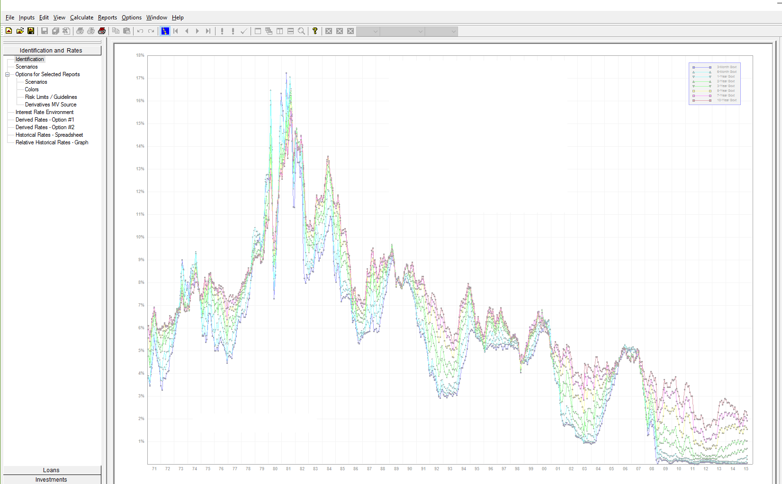
Notes:
This application actually tracks over 60 short and long term interest rate environments.

Slide 9
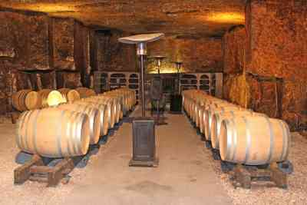
Old code is like…
Notes:
Joel on Software – Things you should never do Part 1, April 2000
Its harder to read then it is to write.
Its never worth throwing away all that debugging.

Slide 10


Feature decision drivers
Notes:
Our company features are based on a couple drivers.
Regulatory or features that have ROI for clients (and us).
Better Reports
More technical analysis

Slide 11
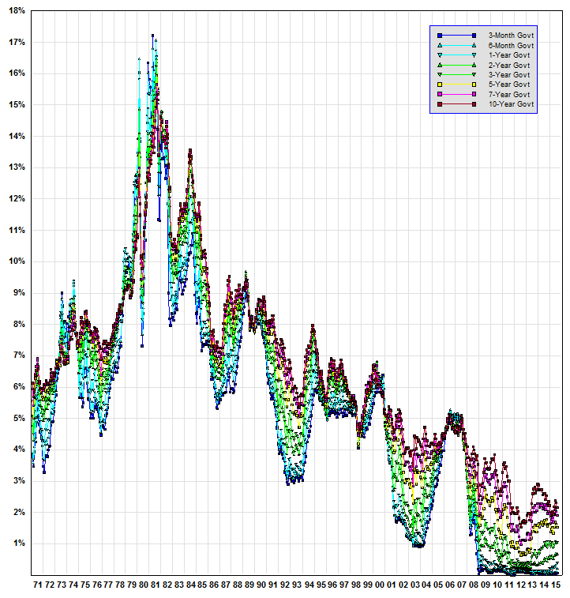
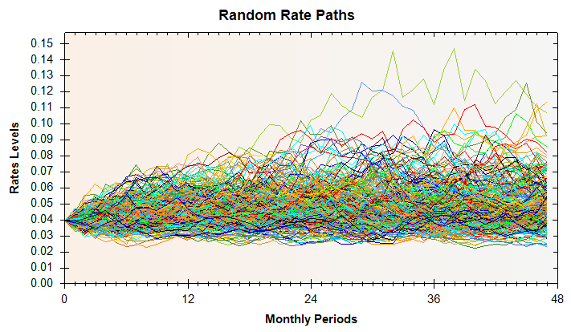
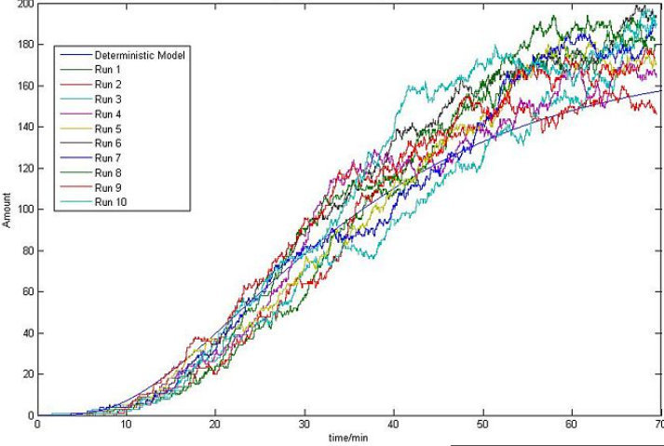
Historic
Stochastic vs. Random
Notes:
http://2008.igem.org/Team:NTU-Singapore/Modelling/Stochastic_Modeling

Slide 12

What do we do with projects?
Ogres are like onions
So are projects!
Notes:
Matryoshka Doll
What are Ogres like?
Layers – many may layers
What happens when you peel and peel and things start to roll off the table?
Drift…
Pulling apart data the structures were massive
Conversion isn’t just a code decision, but business as well.
Whats the future use of this code?
How do we use this and move forward at the same time?

Slide 13
Background
Some Details on our Application

Slide 14
Purpose of our application
Asset and Liability Management
Loans/Investments vs Shares/CDs and Borrowings
Fee Income/Loan Loss
Precision
Notes:
Precision – float is not a double.

Slide 15
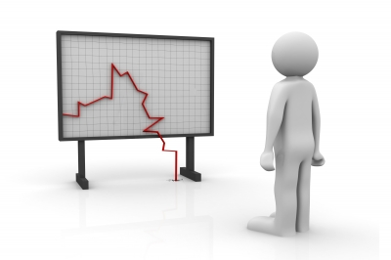
How are interest rates risky?
Notes:
As a consumer locked into a high interest rate is bad. As a financial institution locked into a lower interest rate is bad.

Slide 16



Model technologies
M F C

Slide 17
functional coding
More then it works.

Slide 18
Not really functional
Procedural? Top Down?
How about…
It looked liked C,
But then c++ coded like C,
Followed by c++ with classes
Perhaps it means…
Notes:
Inertial Fusion Sciences & Applications

Slide 19
It functions!
There is something to be said for it producing the right answer in a timely fashion even if it lacks elegance.

Slide 20
Current Issues
Issues with maintaining and adding new features.
Notes:
As Long as…
You don’t mind changing multiple files. In multiple places Multiple times
At times…
Copying the same functions Into different files…With the same lines… In new places…
Ok – not quite that bad … but watch

Slide 21
Globally speaking
We have hundreds!

Slide 22

Five Times
More global variables then countries in the world.
Notes:
Actually over a 1000

Slide 23
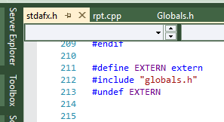
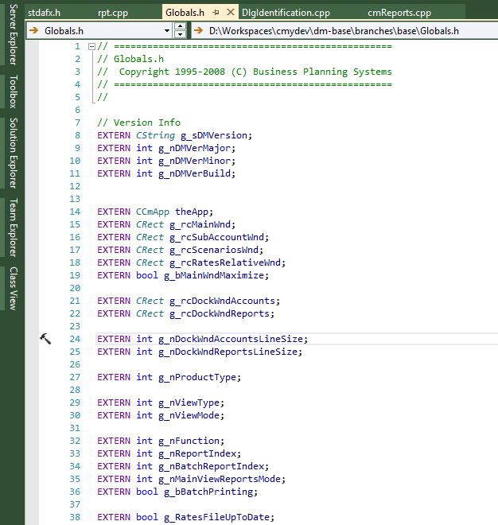
Funny way to extern
Causes a unique initialization issue.
Notes:
If you do extern y hand, in all-but-one files you say "extern Foo f;" and in one file you say "Foo f;" or "Foo f=7;" or Foo f(1,2,"Hello");" or whatever so in that one place it gets initialized but what's happening in your headers is a define of EXTERN to sometimes be "extern" and sometimes be nothing, and including the exact same lines whether you're using the variable or actually declaring it. And that means you can't initialize it other than with a default constructor

Slide 24

Size does matter
When it’s a global pointing to a structure.

Slide 25
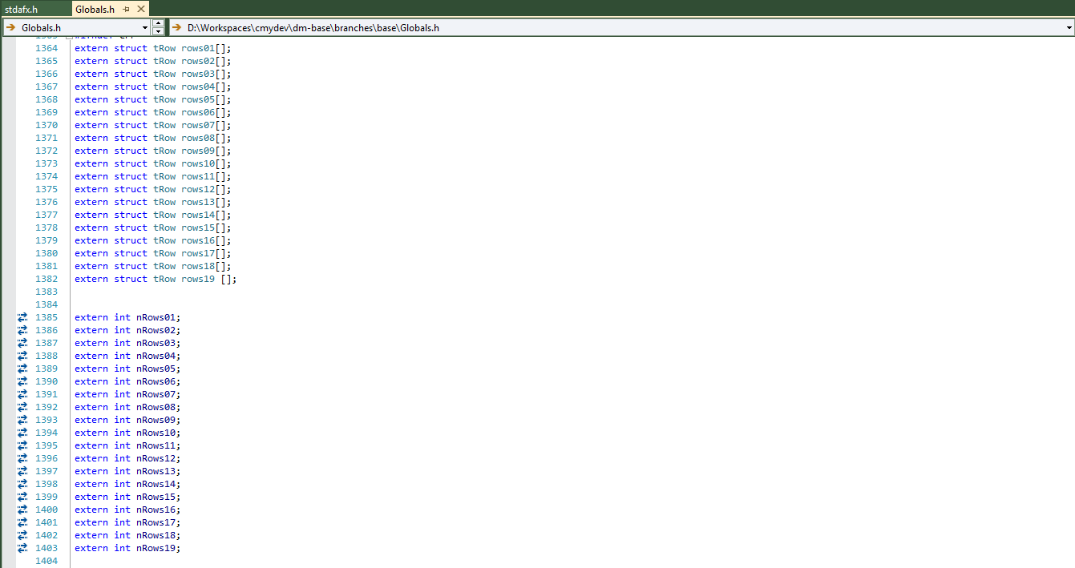
Notes:
Those aren’t just to a struct, but to an array of structs.

Slide 26
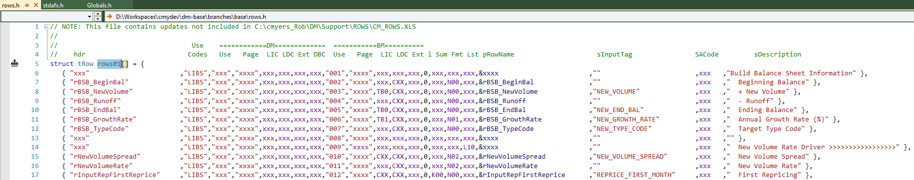
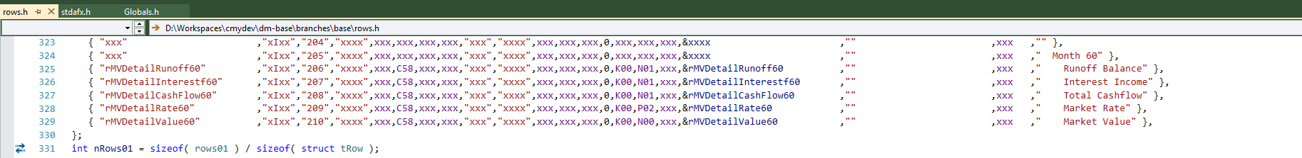
Notes:
324 elements, size - tRow is 84 bytes as a struct which actually includes character pointers. 27,216 not counting pointer data.
NOTE: rBSB_EnbBal and the “xIxx” or “LIBS”

Slide 27
there bad used this way
Non-Locality
No Access Control or Constraint
Concurrency Issues
Memory Allocation Issues
….
Notes:
Concurrency issues -- if globals can be accessed by multiple threads of execution, synchronization is necessary (and too-often neglected). When dynamically linking modules with globals, the composed system might not be thread-safe even if the two independent modules tested in dozens of different contexts were safe. Causes problems with our account data because they are held in rows upon rows of a global structure.

Slide 28
An arrays a data structure
In 630,000 cells!

Slide 29
Remember the structure abovE
Now multiply it by 86 rate environments.
Notes:
324 Rows or 27k bytes. * 86 for each rate environment = 2,322,000
Now think of 360 months or 30 years of data = 835,920,000 or just under a 1gig

Slide 30
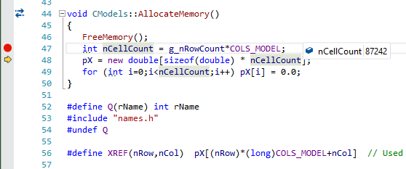
Notes:
87242 * 8 = 697,936

Slide 31
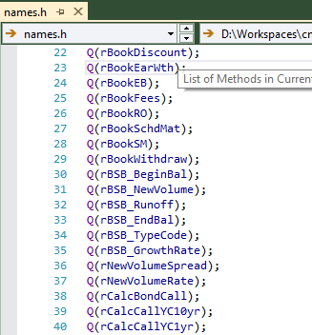
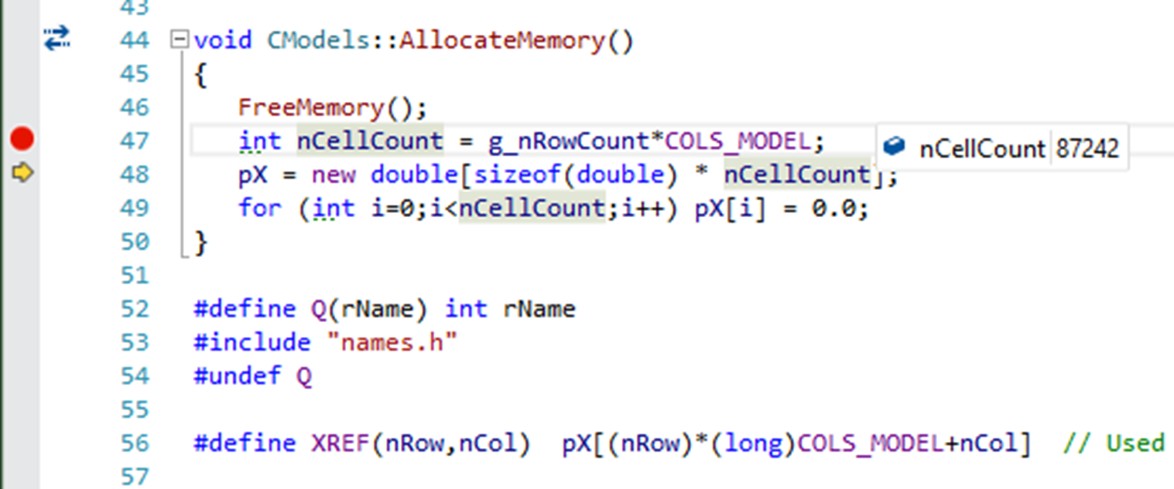

Slide 32
Model Calculations
CModels
Account Data
CAccount
Notes:
All 87,000 cells.

Slide 33
One Method to Calculate Them All!
Really what’s so different between variable or fixed and single pay or amortizing?

Slide 34
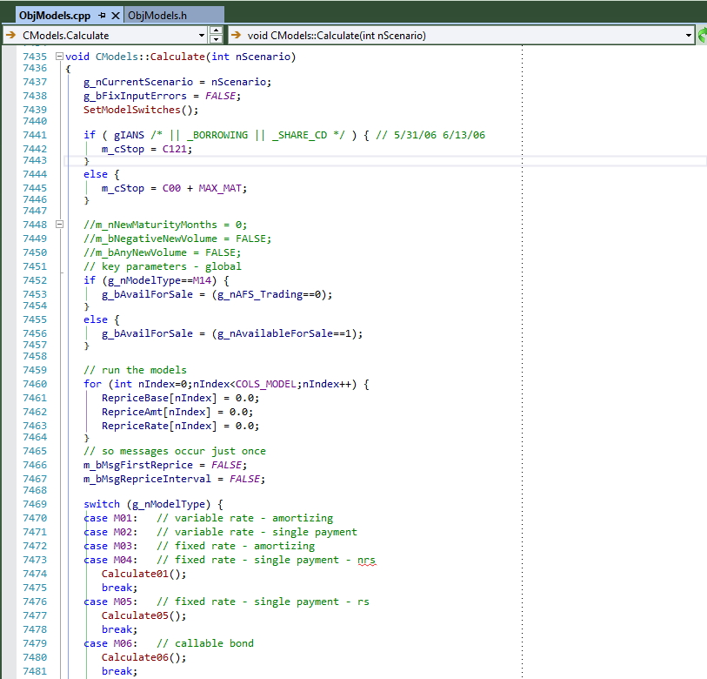
Calculating Data
Our Model class has one calculate method. Using a case statement instead of inheritance.

Slide 35
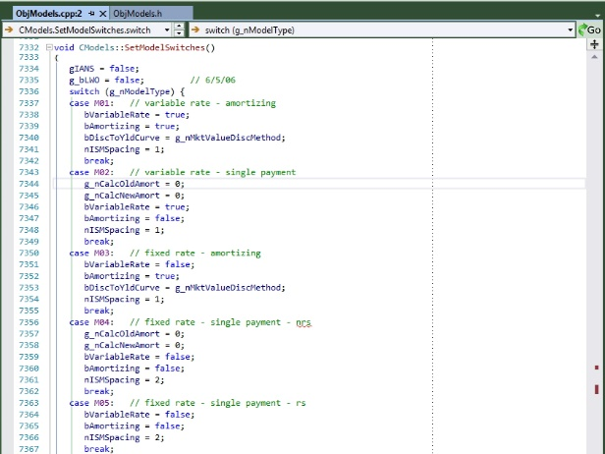
Setting Switches
Notes:
When your not using OOD you use globals mixed with some structure data. The difference between our first four types is a logic tree.

Slide 36
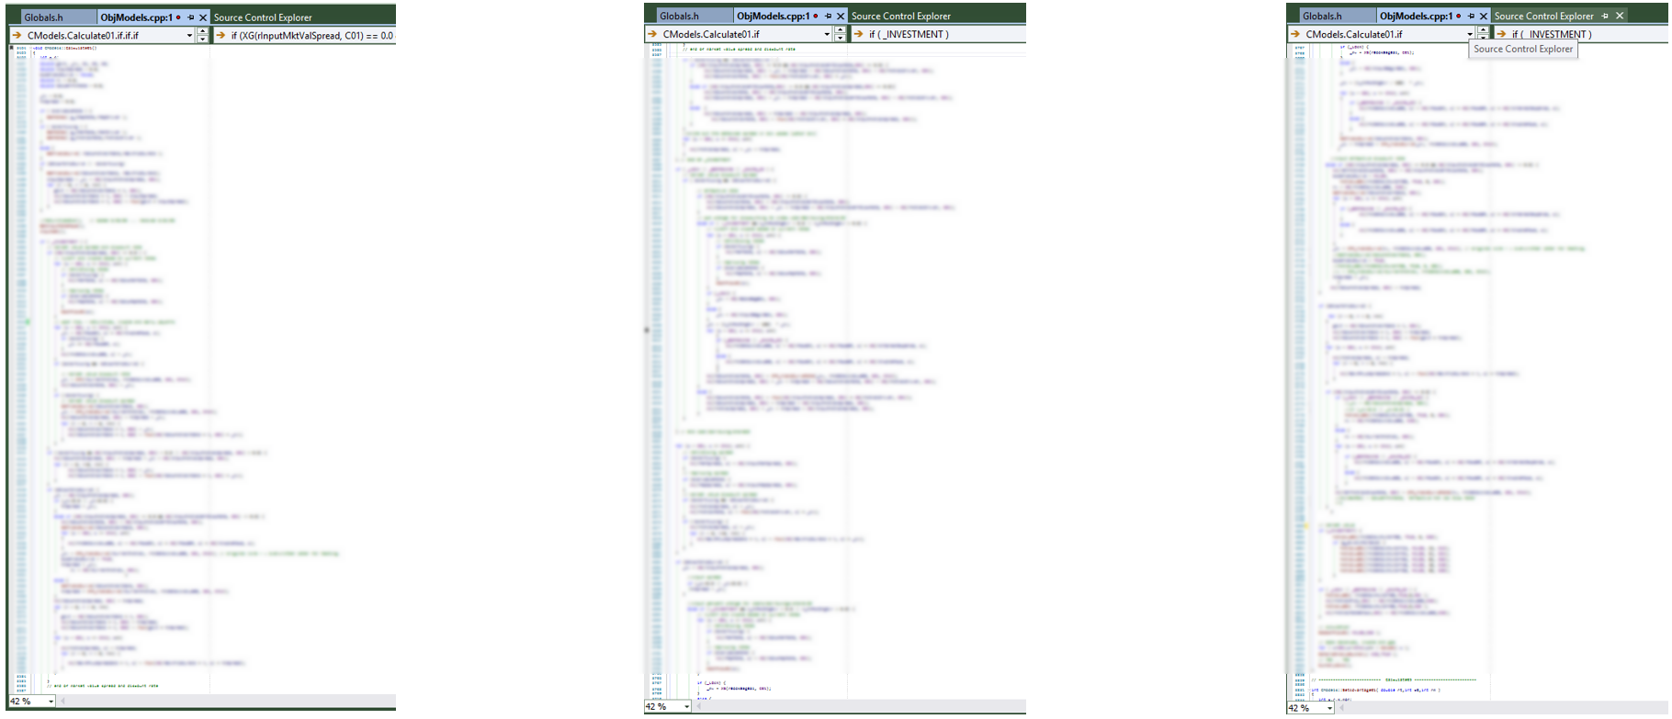
One Method, One Slide, 400 Lines
Notes:
We should be using better coding practices, but this is what functional design from the 90’s grew into. This is a small function.

Slide 37
Massive Methods
Who needs a 15/25/35 line rule?

Slide 38
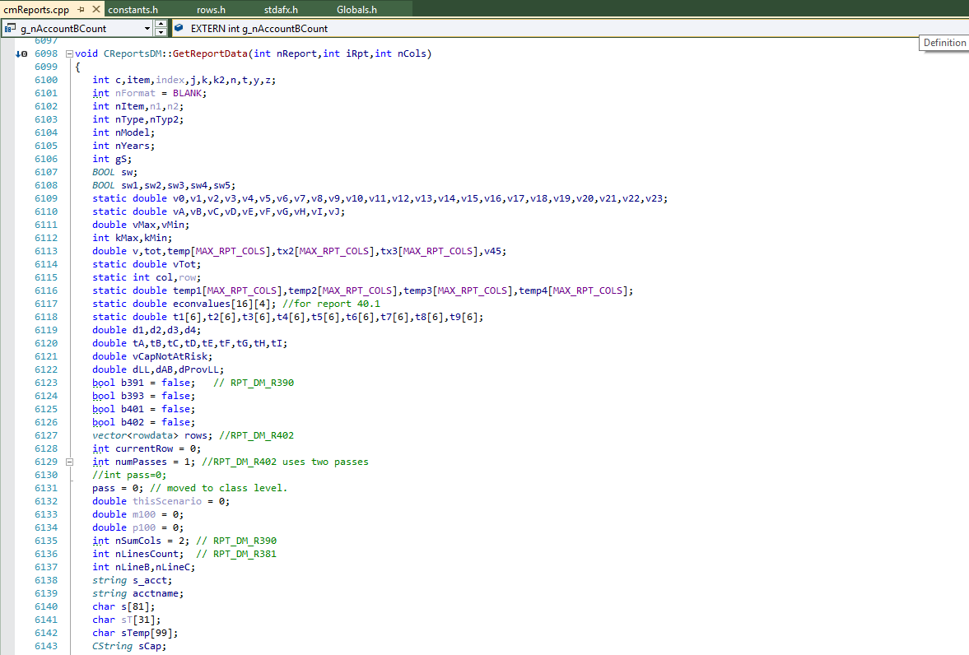

Slide 39
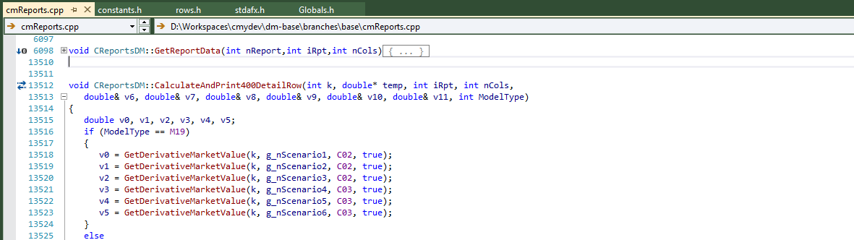
Notes:
Notice the ending line of the collapsed function? 7,412 lines.

Slide 40
Adding a Report
In 24 Easy Steps!
Notes:
My first task learning the code. My second wish – to rewrite it.

Slide 41
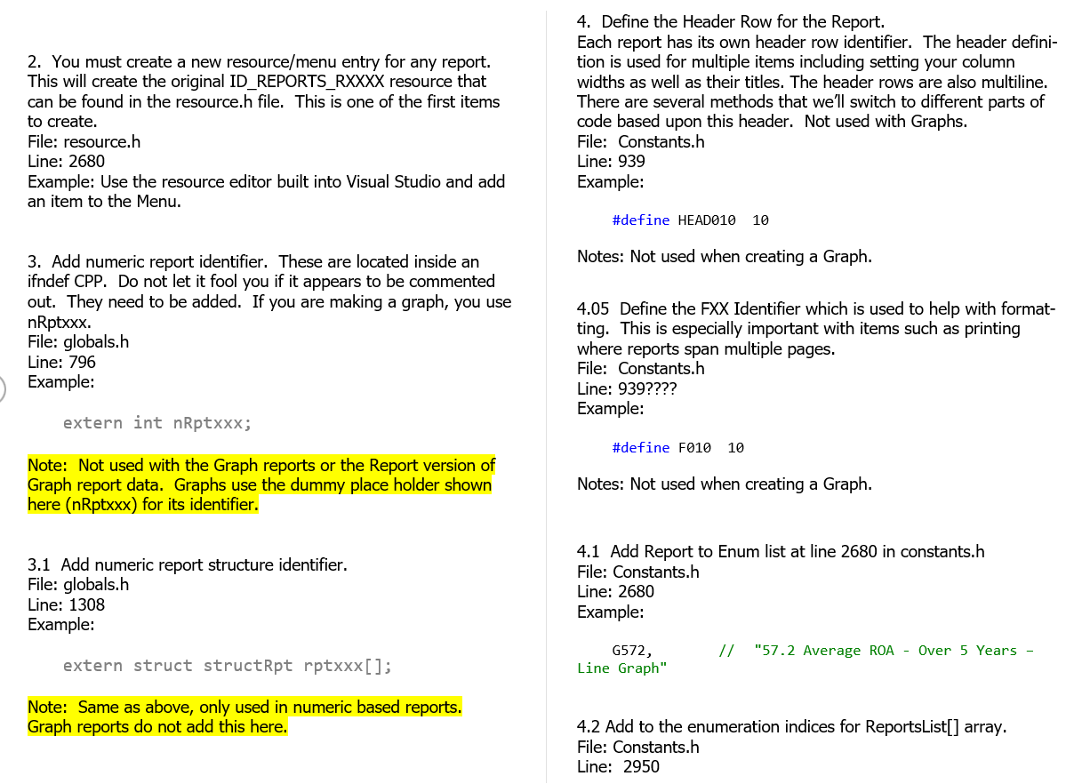
original Way
Notes:
2. You must create a new resource/menu entry for any report. This will create the original ID_REPORTS_RXXXX resource that can be found in the resource.h file. This is one of the first items to create.
File: resource.h
Line: 2680
Example: Use the resource editor built into Visual Studio and add an item to the Menu.
3. Add numeric report identifier. These are located inside an ifndef CPP. Do not let it fool you if it appears to be commented out. They need to be added. If you are making a graph, you use nRptxxx.
File: globals.h
Line: 796
Example:
extern int nRptxxx;
Note: Not used with the Graph reports or the Report version of Graph report data. Graphs use the dummy place holder shown here (nRptxxx) for its identifier.
3.1 Add numeric report structure identifier.
File: globals.h
Line: 1308
Example:
extern struct structRpt rptxxx[];
Note: Same as above, only used in numeric based reports. Graph reports do not add this here.
4. Define the Header Row for the Report.
Each report has its own header row identifier. The header definition is used for multiple items including setting your column widths as well as their titles. The header rows are also multiline. There are several methods that we’ll switch to different parts of code based upon this header. Not used with Graphs.
File: Constants.h
Line: 939
Example:
#define HEAD010 10
Notes: Not used when creating a Graph.
4.05 Define the FXX Identifier which is used to help with formatting. This is especially important with items such as printing where reports span multiple pages.
File: Constants.h
Line: 939????
Example:
#define F010 10
Notes: Not used when creating a Graph.
4.1 Add Report to Enum list at line 2680 in constants.h
File: Constants.h
Line: 2680
Example:
G572, // "57.2 Average ROA - Over 5 Years – Line Graph"
4.2 Add to the enumeration indices for ReportsList[] array.
File: Constants.h
Line: 2950

Slide 42
What’s New?
Creating new classes with better design.

Slide 43
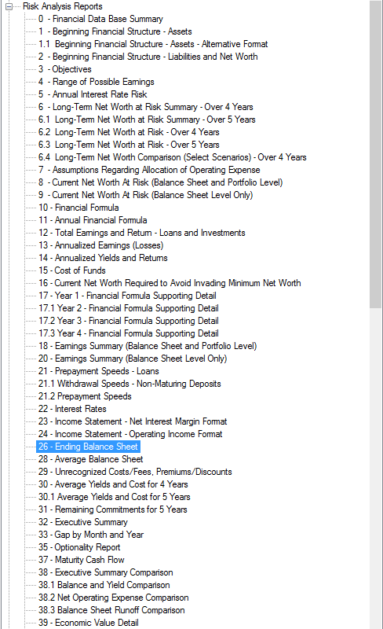
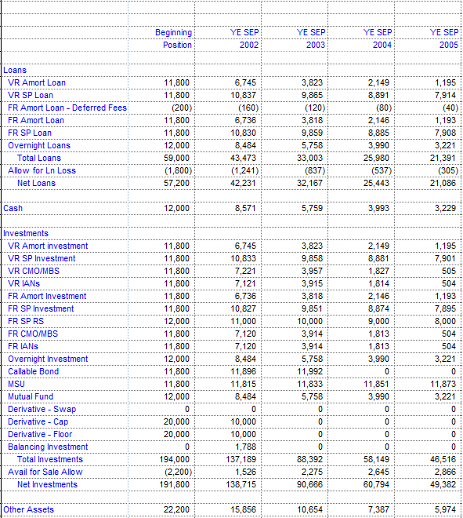
Reporting

Slide 44
Why we revamped reports
GetData

Slide 45
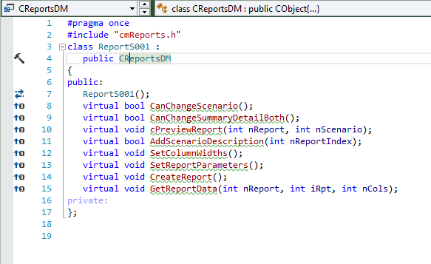
Classy Way

Slide 46
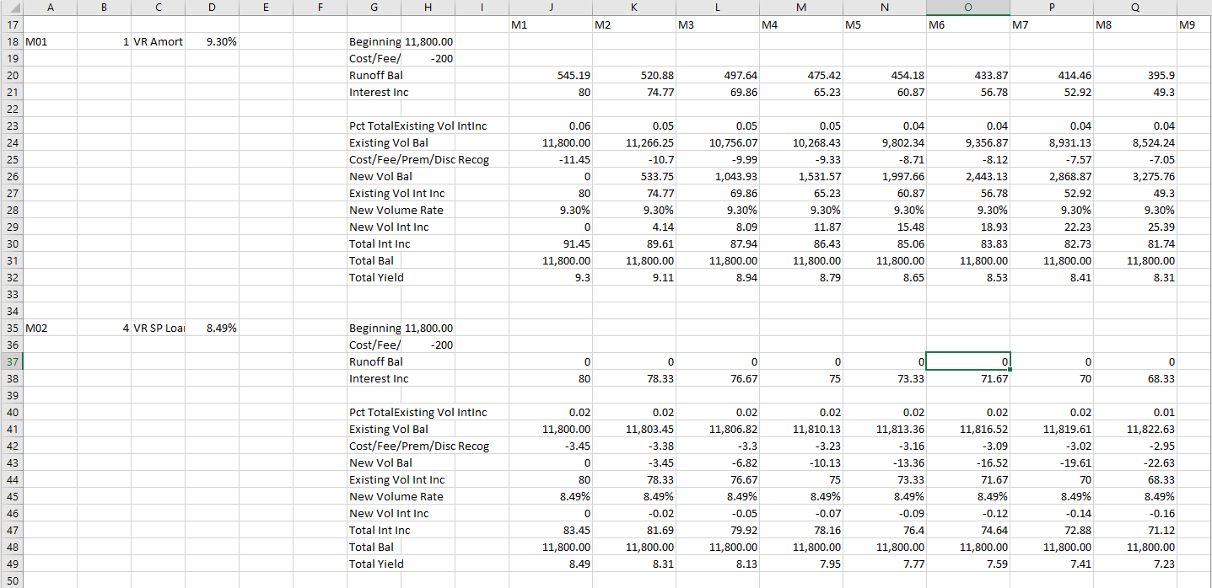
Add on modules
Notes:
Output – considered for AMP
Tested with OpenMP
Month by month requirement – account by account worked.

Slide 47
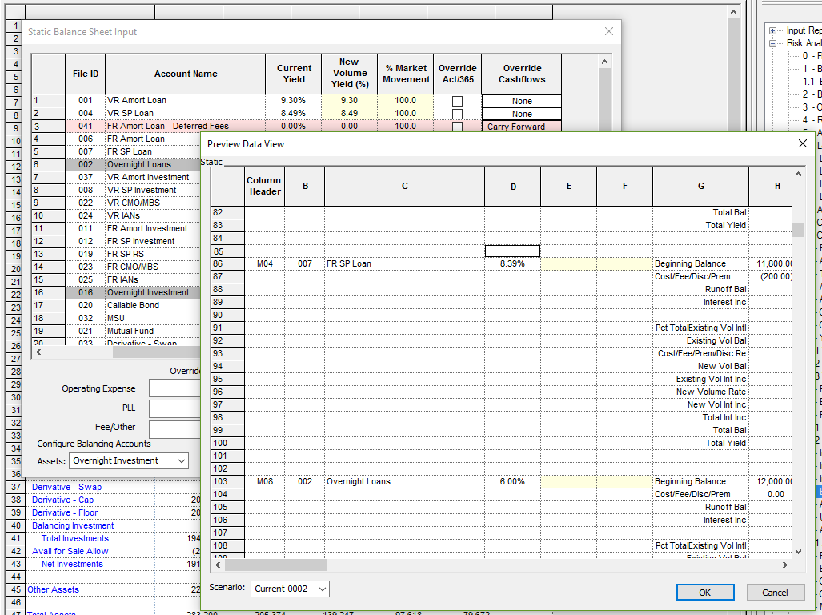

Slide 48
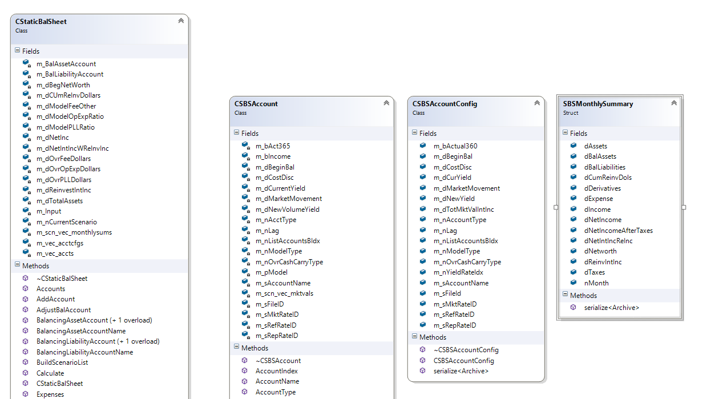
Notes:
Wonderful to debug.
Easier to change.
Far better being self documented.

Slide 49
Implementing stochastic
Onions…
Stochastic with our model structure?
Data separate from index?
If we made new classes how to implement?
Worth?

Slide 50
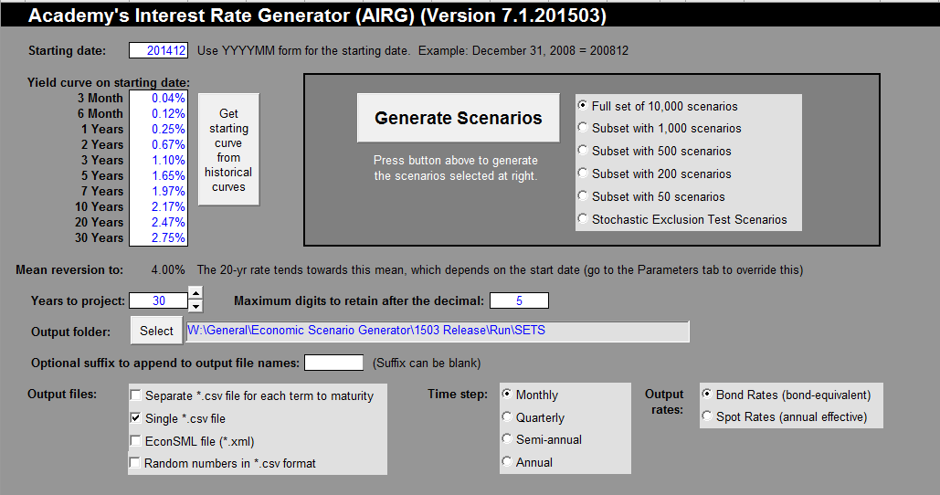
Spreadsheet for paths
Notes:
Generate the paths
Import the paths into the model.

Slide 51
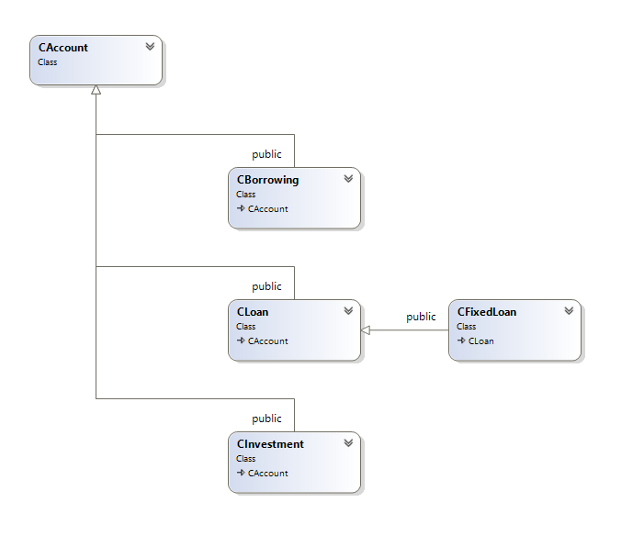
New model classes
Notes:
So if we made new classes how?
Multi-inheritance story.

Slide 52
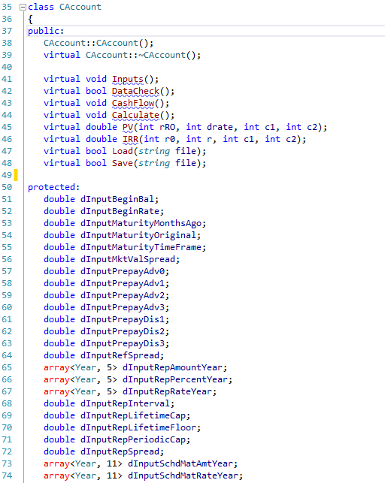
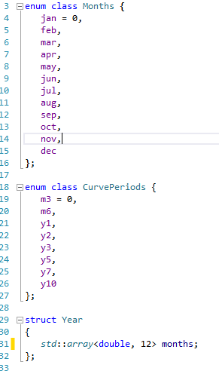
New model classes

Slide 53
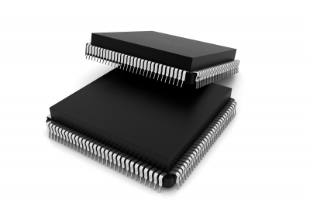
IN Testing
C++ AMP
Threads/
Open MP
Notes:
Parallel with both
- May get more speed with amp but will need more design testing.

Slide 54
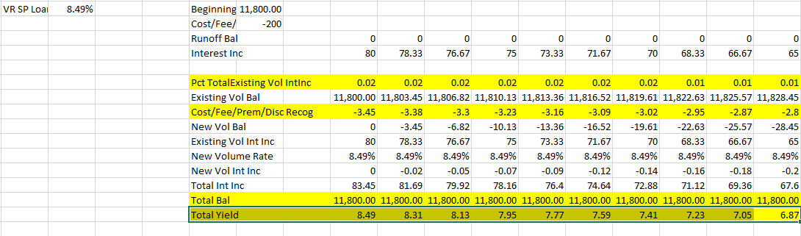
Calculation challenges

Slide 55
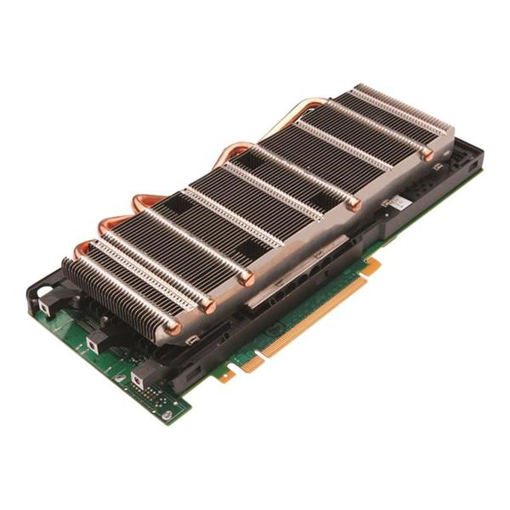
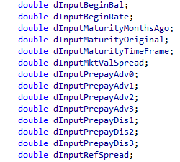
Why?
Notes:
Ways accounts are calculated – month dependent
Double vs Float
Still to test specific hardware M2090 higher floating point with precision – still not double.
Nvida samples all float

Slide 56
Six Years of Lessons

Slide 57
Reading code is hard.

Slide 58
Source Control is my Friend

Slide 59
Refactor, repurpose but don’t rewrite!

Slide 60
Tools Matter
Notes:
GLS/Keynote Speech
Microsoft Static Analysis as well as Others

Slide 61
Team's are better a little c++ is a good thing.

Slide 62
We all help each other become better developers

Slide 63
Future Items
Demo code will be updated here later in the month of October.
https://github.com/csystemsllc/cppcondemo

Slide 64
Questions?

